Slide 1

NTAC Update Wednesday 22 October 2019 Mike Hulme, Scott Renner

Slide 2
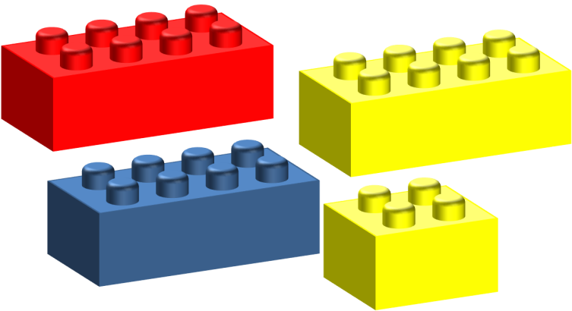
NIEM Technical Architecture Committee
We create and approve technical specifications that
Define NIEM conformance
Ensure a fit between components defined by the NIEM domains
We are a voluntary consensus standards body

Slide 3
JSON
Encoding NIEM data in JSON format
Guidance available now: niem.github.io/json
Specification in development
Defining NIEM exchange using JSON technology
NIEM XML to NIEM JSON translator

Slide 4
Simplified IEPD Replacement
Convention over configuration
Consider new terminology – replacing “IEP” and “IEPD”
Message -- for IEP
Message format -- for IEP Class
Message description -- for IEPD
NIEM Message Description Specification

Slide 5
Metadata
Classification metadata – we have ISM and NTK
Privacy metadata (for health care, etc.)
Releasability metadata – CUI
Metadata support in NDR

Slide 6
Tool Architecture
Archive
JSON Schema Generator
JSON Schema
Easy – Mode UI
(Movement)
Model
Description
UML Generator
UML
Expert – Mode UI
(SSGT)
XML Schema Generator
XML Schema
Documentation Generator
Documentation
Model Source
NIEM Releases

